Slide 1
$ git stash
Save your code without making a commit

Slide 2
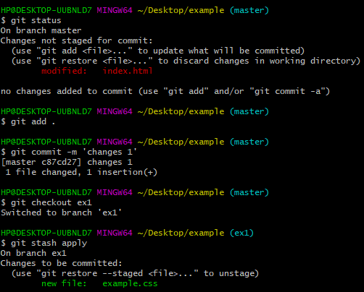

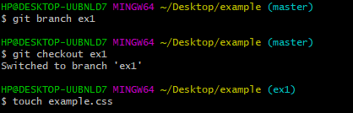


Example of $ git stash

Slide 3


So, let’s Use
Take a good nap

Slide 4
$ git bisect
Perform binary between two given commits and presents you with a specific commit’s details

Slide 5
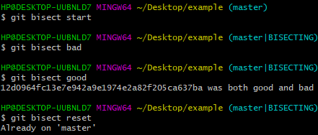
Example of $ git bisect

Slide 6


Slide 7
$ git reflog
Git keeps updates to the tip of branches using mechanism called Reference Logs or “reflogs”.

Slide 8
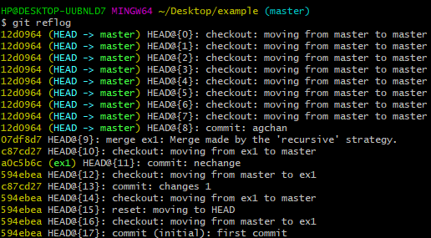
Examples of $ git reflog

Slide 9
$ git diff
Shows you the changes in the file after doing a commit

Slide 10
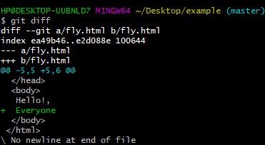
Examples of $ git diff

Slide 11
$ git switch
The “switch” command allows you to switch your current HEAD branch

Slide 12
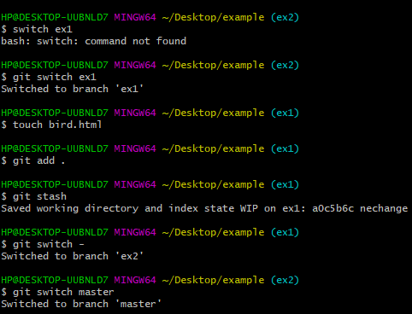
Examples of $ git switch

Slide 13
$ git rebase
Process of integrating a series of commits on top of another base tip

Slide 14
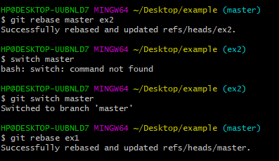
Examples of $ git rebase

Slide 15
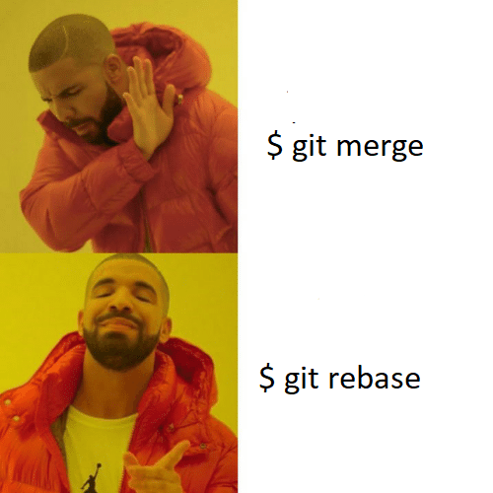

Slide 16
$ git cherry-pick
Choosing a commit from one branch and applying it to another branch

Slide 17
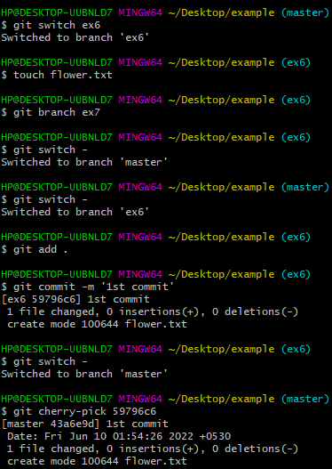
Example of $ git cherry-pick

Slide 18


